Slide 1
CS460 - Senior Design
Team 5 – VR Application Research & Development
T. Avery Eich
Asad Ashur
Daniel Johnson

Slide 2
Midterm Status Report
Research Data Collection
Data Application Development
Dev. Tool and Hardware Setup

Slide 3
Research Data Collection
Asad Ashur

Slide 4
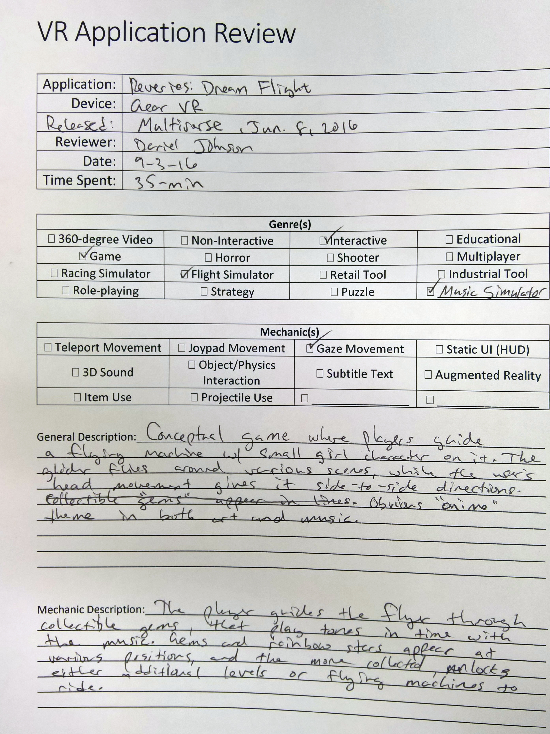
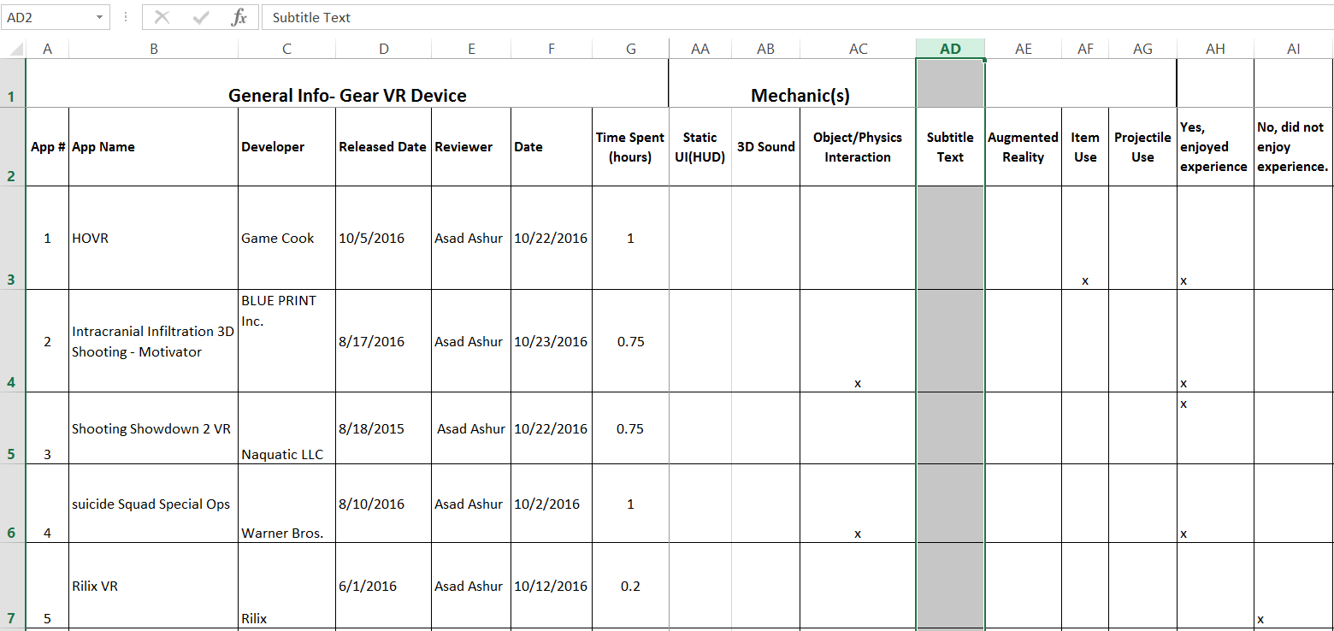
Research Data Collection
Manual Entry of Data (paper/excel)
Collected from application “review” process.
Included application metadata and subjective descriptions.

Slide 5

Research Data Storage
Desired visibility of data, including analysis and relation.
Developed Entity-Relationship Diagram based on the application characteristics.
To make data entry and manipulation easier, we developed a data-driven desktop application.

Slide 6
Data Application Development
Daniel Johnson

Slide 7
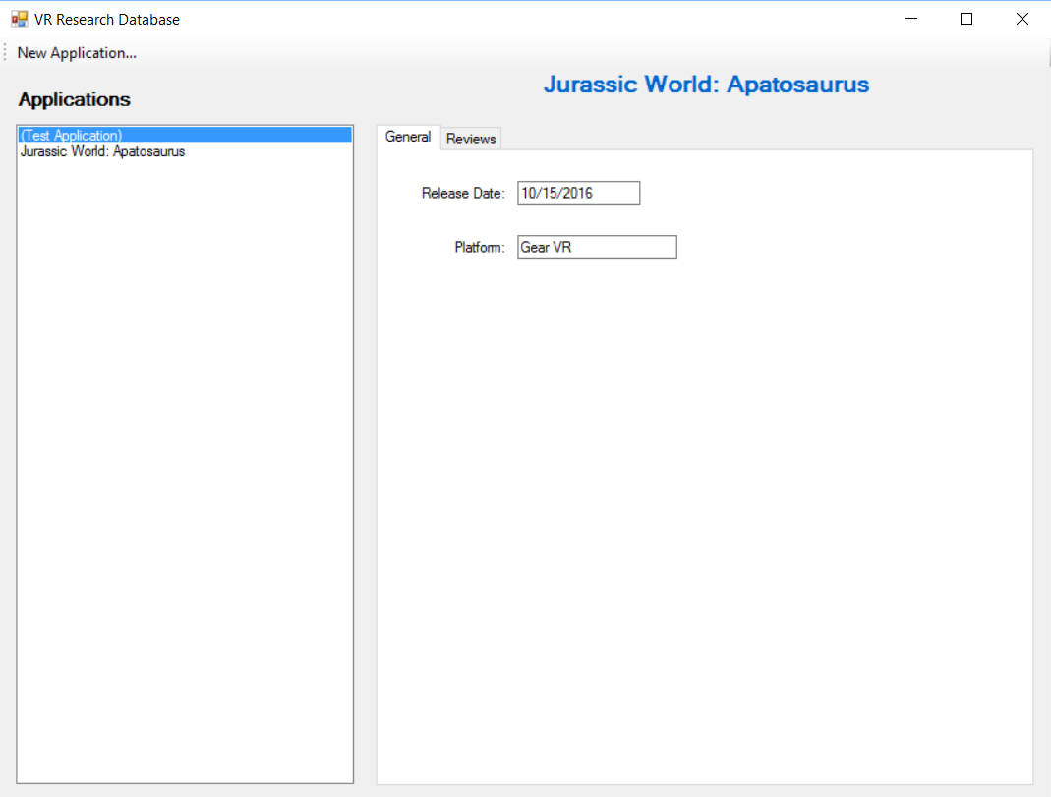

Data Entry and Collection
Microsoft Windows Forms
GitHub

Slide 8
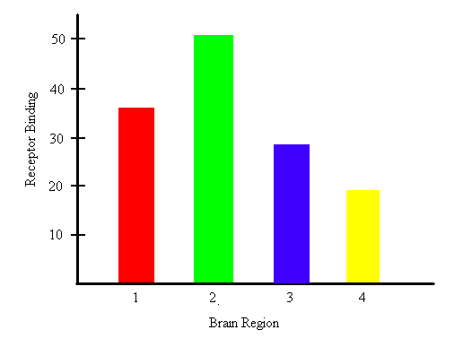
Data Reporting
Find popular attributes or trends.
Keep track of multiple application reviewer data

Slide 9
Dev. Tool & Hardware Setup
T. Avery Eich

Slide 10
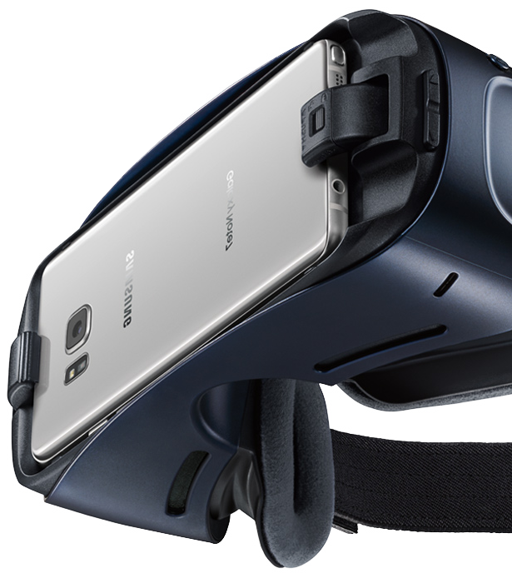
Gear VR Development
Why Gear VR?
Mobile
Accessible (price)
Unity Integration support.
Oculus and Android SDK Packages
Easy to install deploy
Same as Android application development cycle
Plenty of documentation and support for Android

Slide 11

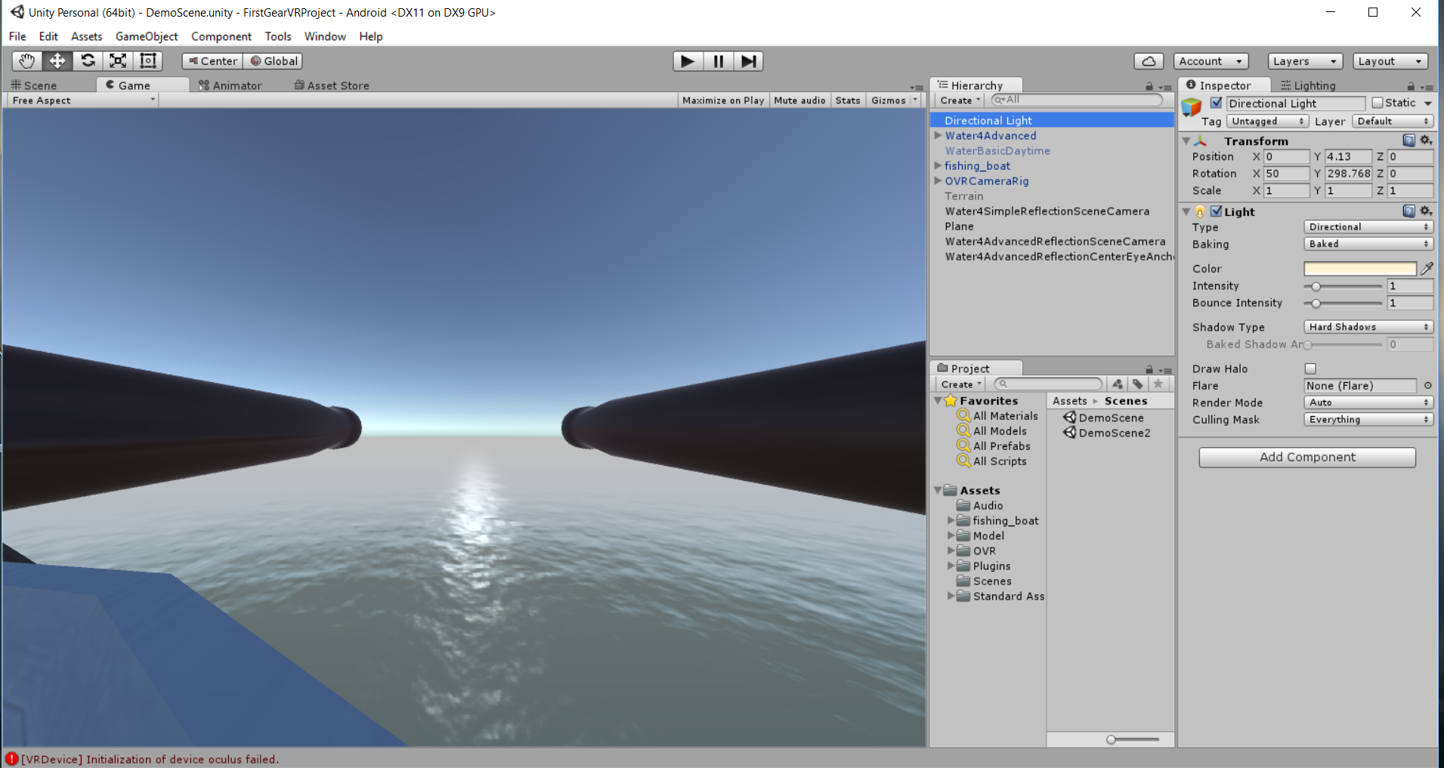
Unity Development
Unity 5 Integration Package from Unity3D.com
Imported package to Unity
Reviewed example projects
Developed custom project
Deployed application to Gear VR
Gained experience with deployment pipeline (testing).

Slide 12
Conclusion
Future Plan
Research Oclulus Rift project deployment.
Research integration of AR plugin (Vuforia) to gain motion tracking with Gear VR.
Fully develop application implementation plan to be executed second semester.
Use research data and analysis to drive the application vision.

